Slide 1
Introduction to Information Systems and Programming
Abstract Class and Interface
[some materials adopted from Liang, Introduction to Java Programming]

Slide 2
Abstract Class
Inheritance: derives new classes from existing classes
Superclass: more general; Subclass: more specific
Example: GeometricObject models common features of geometric objects
We can compute areas and perimeters for all geometric objects, it is better to define getArea() and getPerimeter() methods in the GeometricObject class
But these methods cannot be implemented in GeometricObject, as their implementation depends on specific type of geometric object (Circle or Rectangle)
Solution: Can define them as abstract methods in GeometricObject, provide concrete implementation in the concrete subclass
GeometricObject becomes an abstract class

Slide 3
Example: Abstract Class
An abstract class
public abstract class GeometricObject {
private String color;
protected GeometricObject(){
this.color = "yellow";
}
protected GeometricObject(String color) {
this.color = color;
}
public String getColor() {
return color;
}
public void setColor(String color) {
this.color = color;
}
public abstract double getArea();
}
An abstract method

Slide 4
Abstract Class
Cannot create instance of abstract class using the new operator
An abstract method is defined without implementation
Implementation provided by subclass
A class that contains abstract methods must be defined as an abstract class
Practical advantage of abstract class: generic programming

Slide 5
Generic Programming using Abstract Class
public class TestGeoObject {
public static boolean equalArea(GeometricObject o1, GeometricObject o2){
return o1.getArea() == o2.getArea();
}
public static void main (String[] args){
Circle c = new Circle();
Rect r = new Rect();
System.out.println( equalArea(r,c));
}
}

Slide 6
Cohort Activity (true or false)
1. An abstract method cannot be contained in a concrete class
2. A subclass of an abstract superclass does not need to implement all the abstract methods
3. An abstract class can still define its constructors

Slide 7
Cohort Activity (true or false)
4. An abstract class must contain abstract method
5. A subclass can be abstract even if its superclass is concrete
6. An abstract class can be used as a data type

Slide 8
Interface
Interface is a class-like programming construct that contains only constants and abstract methods
In many ways similar to abstract class, as we will see
But its intent is to specify common behavior / characteristics of objects of related classes or unrelated classes, e.g., comparable, eatable, etc

Slide 9
Interface Example
public interface Eatable {
public abstract String howToEat();
}
class Animal{
}
class Chicken extends Animal implements Eatable {
public String howToEat(){
return "chicken: fry it";
}
}
class Dog extends Animal {
}
class Chocolate implements Eatable {
public String howToEat() {
return "chocolate: eat everyday";
}
}

Slide 10
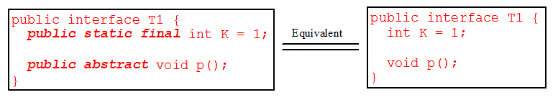
Interface
In interface, since all data fields are public static final and all methods are public abstract, these modifiers are ok to be omitted
Similar to abstract class:
Cannot create an instance from an interface using the new operator
Ok to use an interface as a data type for a variable
Use it for casting
etc

Slide 11
Comparable Interface
Suppose you want to design a generic method to sort the objects of the same type: circles, rectangles, students, fruits
We need common behavior for the objects: comparable
Java provide the Comparable interface for this purpose
Classes that implement the Comparable interface become comparable

Slide 12
Comparable Interface
Comparable interface provided by Java:
public interface Comparable<E> {
public abstract int compareTo(E o);
}

Slide 13
Comparable interface example
class Circle extends GeometricObject implements Comparable<Circle>{
private double radius = 1;
Circle() {
}
Circle (double radius) {
this.radius = radius;
}
public int compareTo(Circle c){
if (this.radius > c.radius)
return 1;
else if (this.radius == c.radius)
return 0;
else
return -1;
}
}

Slide 14
Comparable Interface
Implements Comparable<E>: provides implementation for the abstract method public int compareTo(E o)
Comparable interface is a generic interface, the generic type E is replaced by a concrete type when implementing the interface
Classes Integer, String, Date, etc all implement Comparable, thus they are comparable

Slide 15
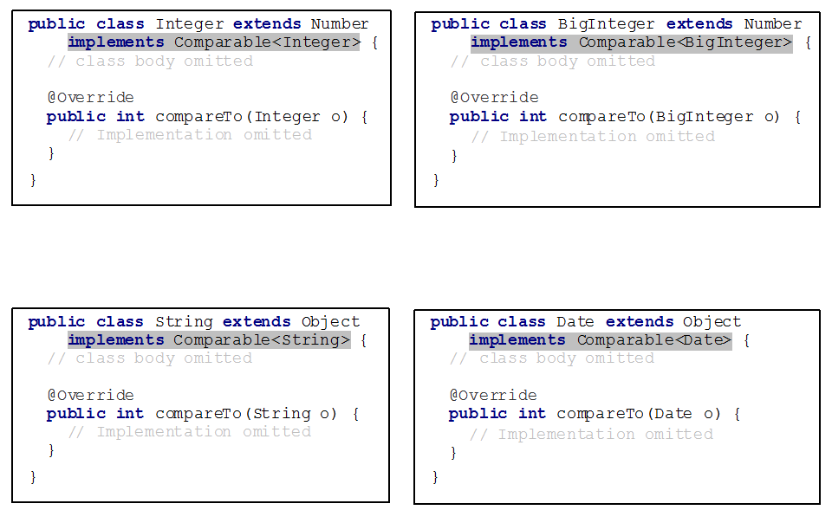
Comparable Interface

Slide 16
Comparator Interface
Comparator interface can be used to:
Provide addition way of ordering
Comparable<E>.compareTo() defines the “natural” ordering for E
Comparator<E>.compare() defines additional, alternative ordering for E
Enable comparison for objects which their classes do not implement comparable

Slide 17
Comparator Interface Example
Allow Integer to be ordered based on their absolute value
public class IntegerAbsComparator implements Comparator<Integer> {
public int compare(Integer a, Integer b) {
if (Math.abs(a) > Math.abs(b))
return 1;
else if (Math.abs(a) == Math.abs(b))
return 0;
else
return -1;
}
}
// code skip
Collections.sort(l, new IntegerAbsComparator());

Slide 18
Cohort Activity
Comparable for Octagon
Comparator for Octagon

Slide 19
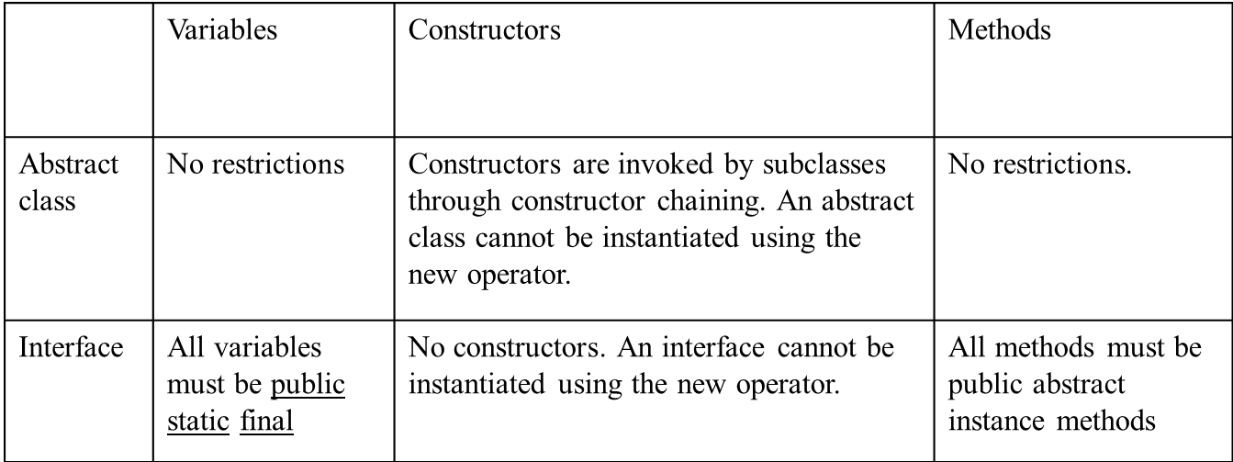
Abstract Class vs. Interface
Interface: all data must be constants
Abstract class: all types of data
Interface: all methods are abstract (signature only)
An abstract class can have concrete methods

Slide 20
Abstract Class vs. Interface
All classes share the same root, Object; but there is no single root for interfaces
Like a class, a variable of an interface type can reference any instance of the class that implements the interface
If a class implements an interface, this interface plays the similar role as a superclass

Slide 21
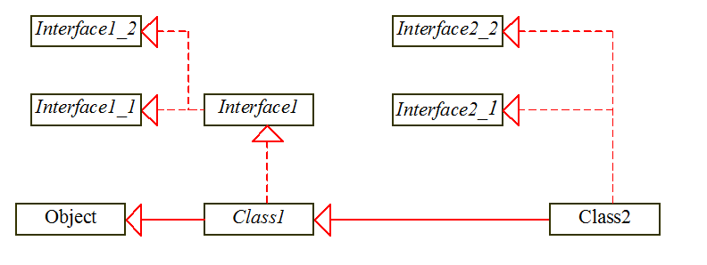
Abstract Class vs. Interface
If c is an instance of Class2, c is also an instance of Object, Class1, Interface1, Interface1_1, Interface1_2, Interface2_1, Interface2_2

Slide 22
Cohort Activity
Implement the software framework in the previous slide

Slide 23
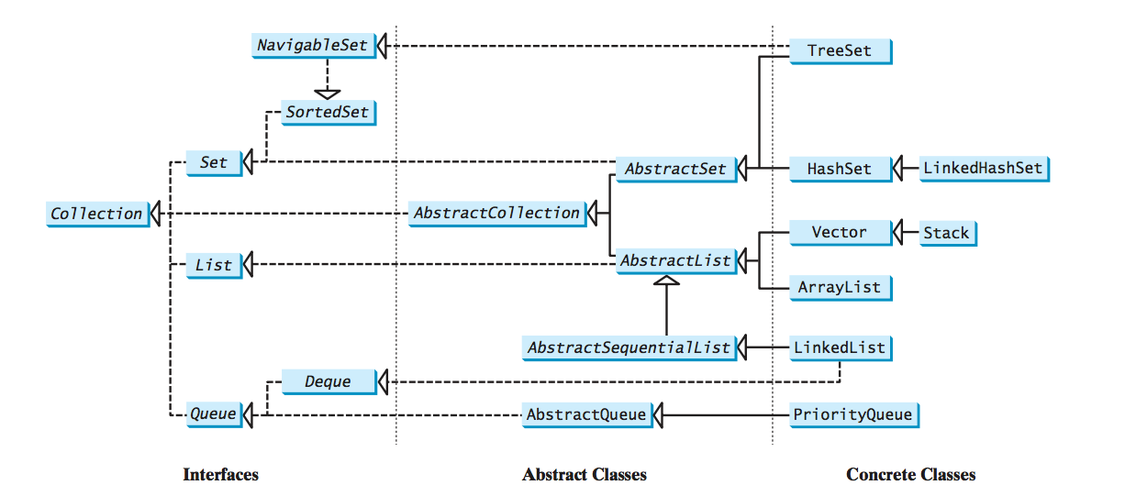
Java Collection Framework

Slide 24
Cohort Activity (true or false)
An abstract method cannot be contained in a concrete class (true, need to be an abstract class)
A subclass of an abstract superclass does not need to implement all the abstract methods (true, in the case the subclass is abstract)
An abstract class can still define its constructors (true, invoked during construction of the concrete subclass)

Slide 25
Cohort Activity (true or false)
An abstract class must contain abstract method (false, but an abstract class cannot be instantiated using the new operator)
A subclass can be abstract even if its superclass is concrete (true, e.g., Object is concrete, GeometricObject is abstract)
An abstract class can be used as a data type (true, have seen this in generic programming example)

